Slide 1


The Impact of COVID-19 on Parcel Volumes: A Surge Driven by E-Commerce

Slide 2


TEAM
KUSH GADHVI
MODUPE BELLO

Slide 3




Agenda
Introduction of ABC
Mission and Vision
Project
Goals
Market Trend Analysis

Slide 4

ABC Parcel
In a nutshell
ABC launched its delivery services in the early 2000s
Known for reliable service, innovative logistics solutions, and customer focused operations.
ABC Parcel experienced challenges during COVID-19, including capacity and operational strain.
Adapted successfully by expanding delivery infrastructure and enhancing e-commerce partnership.

Slide 5

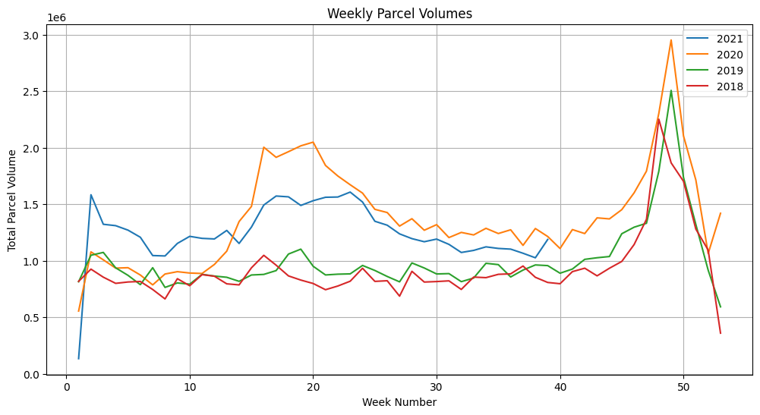
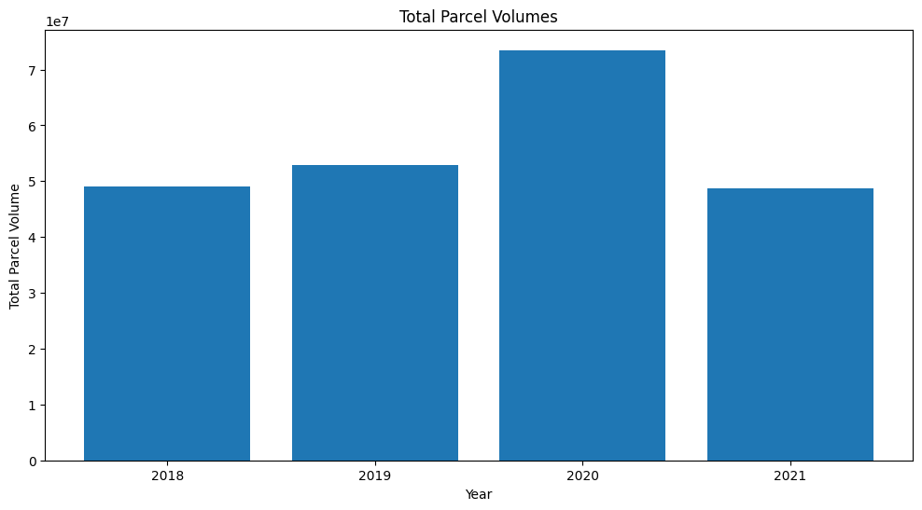
Executive Summary
ABC company’s 2020 parcel volumes trend analysis:
Significant increased compared to 2018 and 2019 years.
Peak season (Weeks 45-50) experienced record-breaking spike, reaching nearly 3 million parcels.
Recommendations:
Invest in infrastructure for efficient peak-season spike management.
Leverage data analytics to predict demand surges and allocate resources optimally.
Focus on customer retention through loyalty programs and improved delivery tracking.
Adjust operational strategies to align with normalized volumes in 2021
Strengthen partnerships with e-commerce platforms and deploy temporary resources for peak weeks.

Slide 6
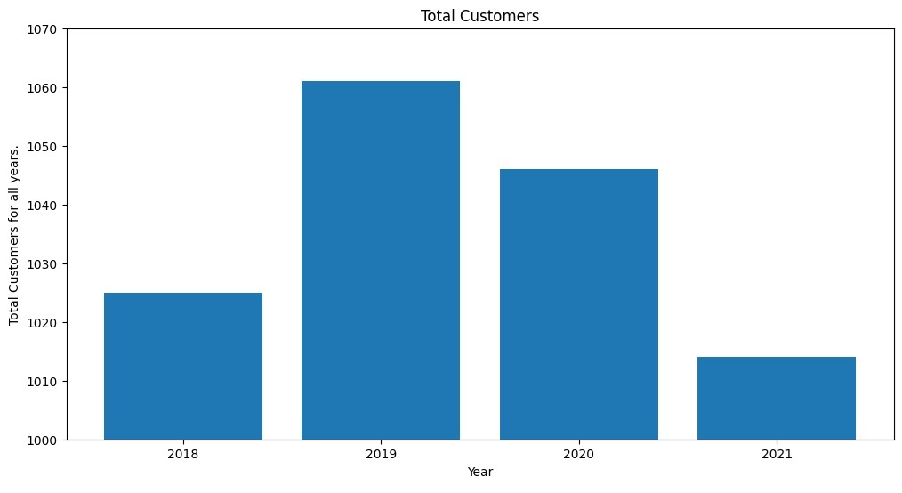
Trends in Customer Growth and Decline: 2018-2021
2018: Total customers around 1025.
2019: Total customers increased to approximately 1061, highest value in observed period.
2020: Customers declined to around 1050 due to COVID-19 saw a parcel delivery spike.
2021: Significant customers drop to approximately 1010, lowest across years due to reduced demand, competition or other factors.

Slide 7
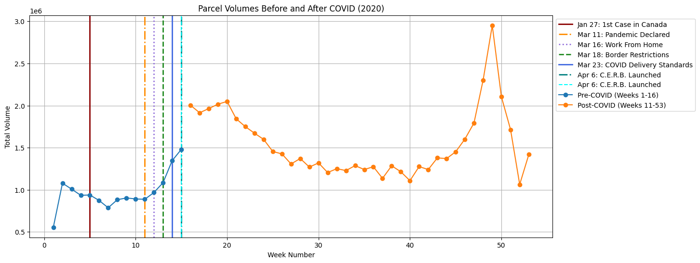
When were customer volumes first impacted by COVID-19?
What events within the COVID timeline may have contributed to the change?
Volume Trends Before and After COVID:
The chart shows a significant shift in parcel volumes before and after the COVID-19 pandemic declaration (Week 11). Pre-COVID (Weeks 1–16) had relatively stable parcel volumes, with a slight upward trend towards the declaration.
Post-COVID Surge and Key Events:
After the pandemic was declared (March 11), parcel volumes initially declined but saw a dramatic increase later in the year (Weeks 40–50), likely due to increased e-commerce during peak season and the impact of C.E.R.B. (Canada Emergency Response Benefit) launched in April.

Slide 8
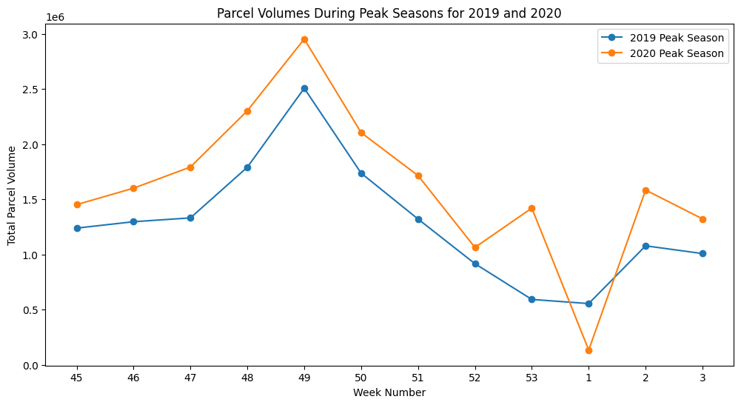
How did COVID-19 impact peak season in 2020?
Comparison of Peak Season Volumes (2019 vs 2020):
The 2020 peak season shows a significant increase in parcel volumes compared to 2019, peaking at approximately 3 million parcels during Week 49. This reflects the impact of increased e-commerce activity during the COVID-19 pandemic.
Post-Peak Drop and Trends:
After Week 49, volumes in both years decline, but 2020 maintains higher levels overall. The sharp spike around Week 2 in 2020 suggests delayed deliveries or extended peak activity compared to 2019.

Slide 9
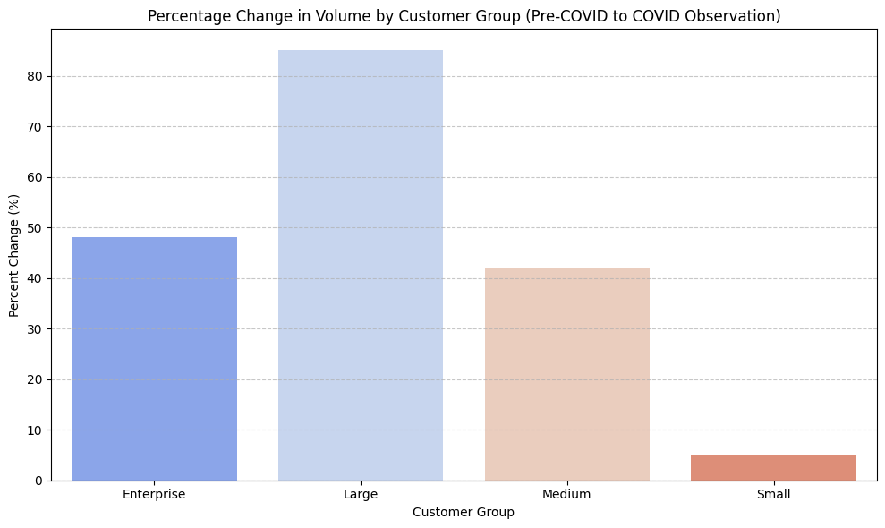
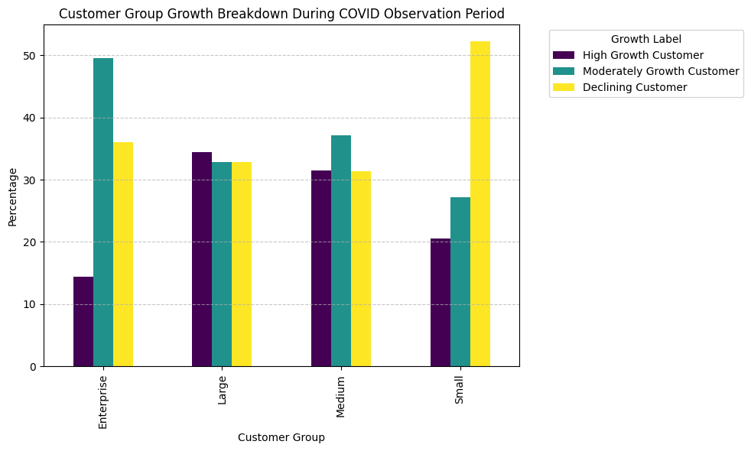
How has COVID affected companies in the different customer groups (Enterprise, Large, etc.)?
What percent of each customer group is growing, moderately growing, and declining during the COVID observation period?
Volume Impact Across Customer Groups: Large customer groups experienced the highest growth (close to 80%) in parcel volumes, while small customers saw minimal growth (<10%), highlighting differences in resilience and demand during COVID-19.
Enterprise customers led in high growth (over 50%), while small customers had the highest percentage of declining customers, reflecting their struggles to sustain operations during the pandemic.

Slide 10
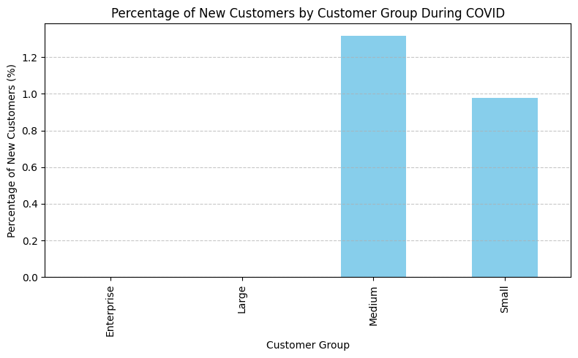
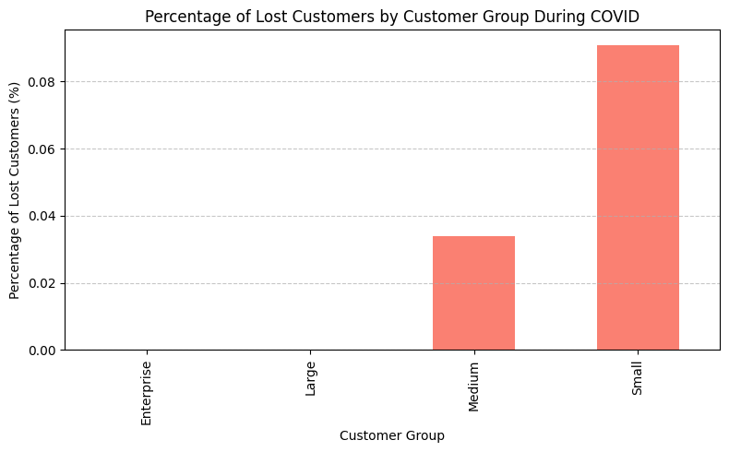
What percent of each customer group are new customers during the COVID observation period?
What percent of 2019 customers in each group did we lose during the COVID observation period?
New Customers During COVID:
The Medium customer group gained the highest percentage of new customers during COVID, followed by the Small customer group, reflecting an influx of new businesses or partnerships during the observation period.
Lost Customers During COVID:
The Small customer group experienced the highest percentage of lost customers (close to 9%), indicating their vulnerability during the pandemic, while Large and Medium customer groups saw moderate losses.

Slide 11
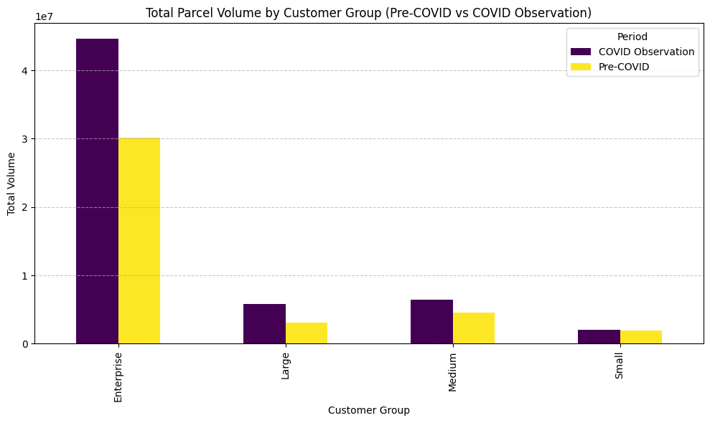
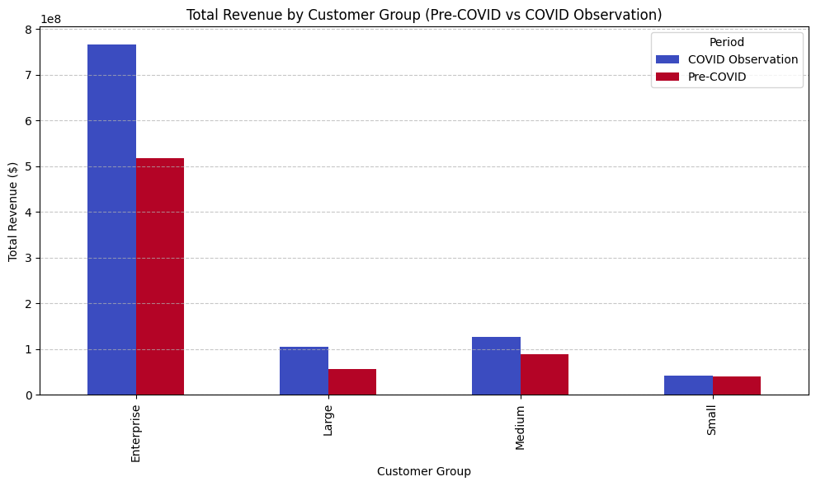
What was the overall impact of COVID on volumes and revenue by customer group?
New Customers During COVID:
saw the highest increase in parcel volumes during the COVID observation period compared to pre-COVID levels, indicating strong demand. Other groups, such as Large and Medium, also experienced moderate volume growth.
Impact on Revenue :Enterprise customers
Enterprise customers led in total revenue, showing significant growth during COVID. In contrast, Small and Medium customer groups generated lower revenues, highlighting a smaller contribution to overall performance.

Slide 12




